Slide 1

Gps Tracking And Anti-Theft Device For Real Vehicles
Ministry of Higher Education
Pyramids High Institute (PHI) for Engineering and Technology
Electronics and Communication Engineering Department
Team Members :
Under Supervision:
Abdelrahman Shrief
Asmaa Mohamed
Sondos Reda
Mohamed Hossam
Mohamed Alaa
Mohamed Nageh
Mahmoud Gaballah
Moamen Morad
Dr. Gamal Elshiekh
Dr. Heba Emara
Dr. Esraa Elrefaay
Dr. Walaa Omar
Dr. Hanaa Ezzat

Slide 2
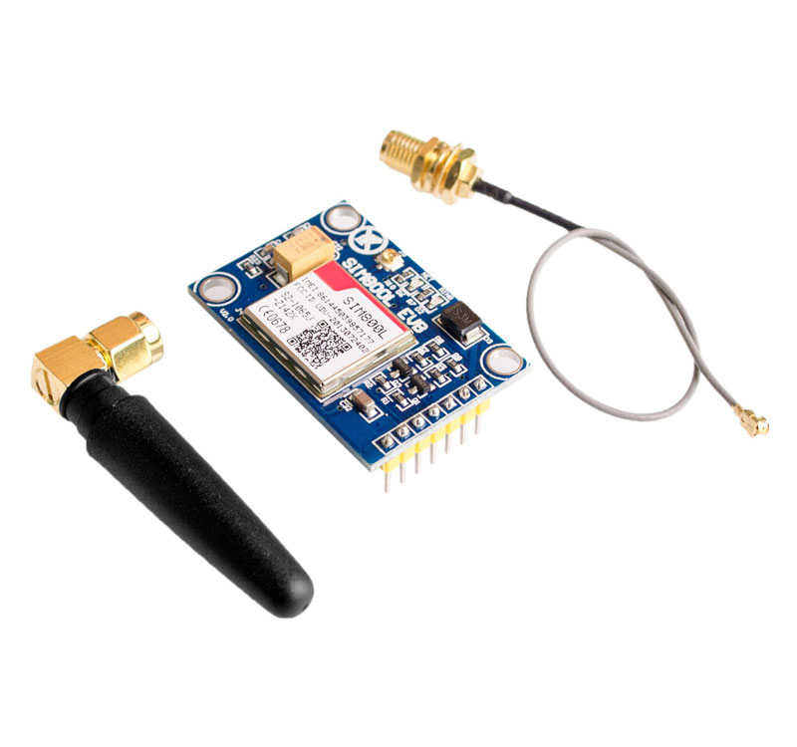
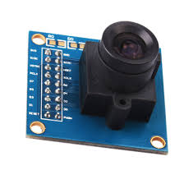
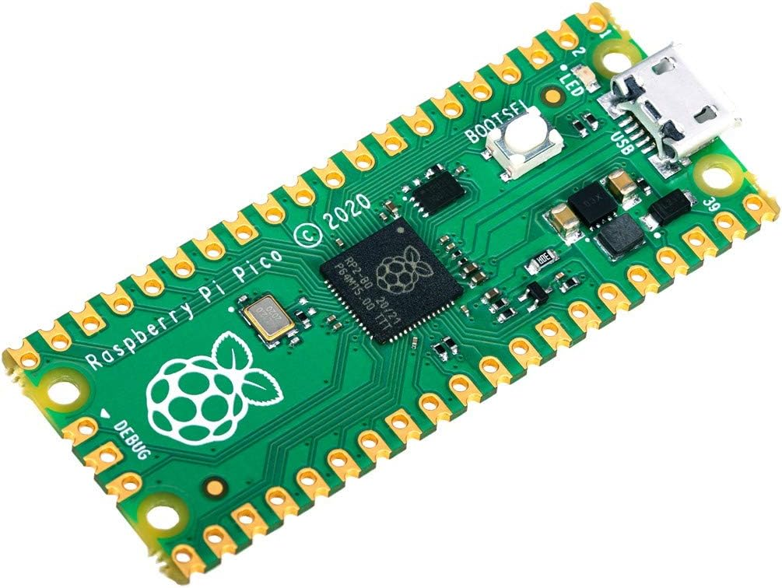
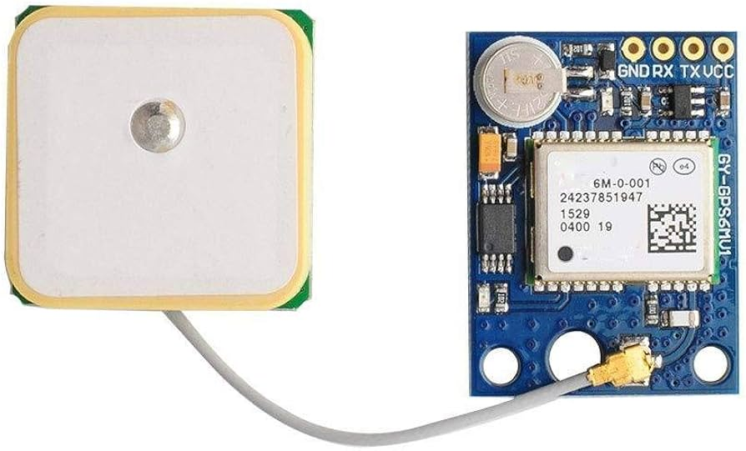
GSM SIM800l V2.0
450LE
OV7670​
175LE
Components
GPS Module Neo-6
LE550​
Raspberry pi pico​
LE660

Slide 3
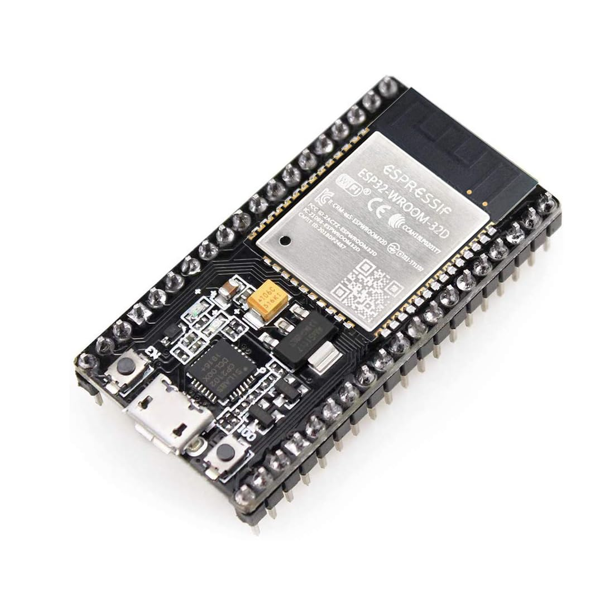
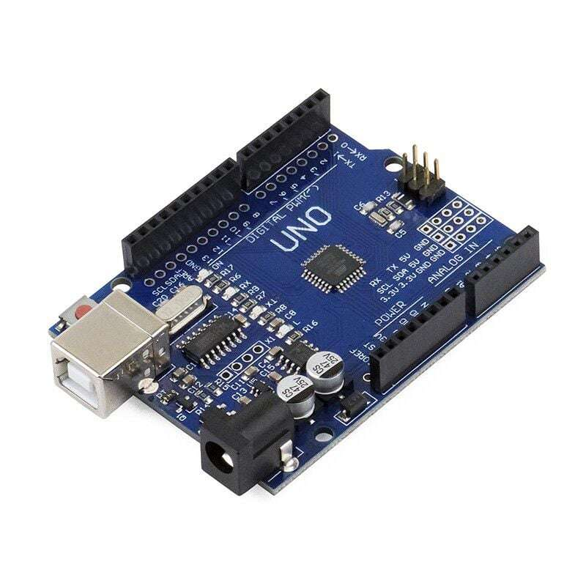
Components
ESP32
LE425
Arduino​ uno R3
LE440

Slide 4
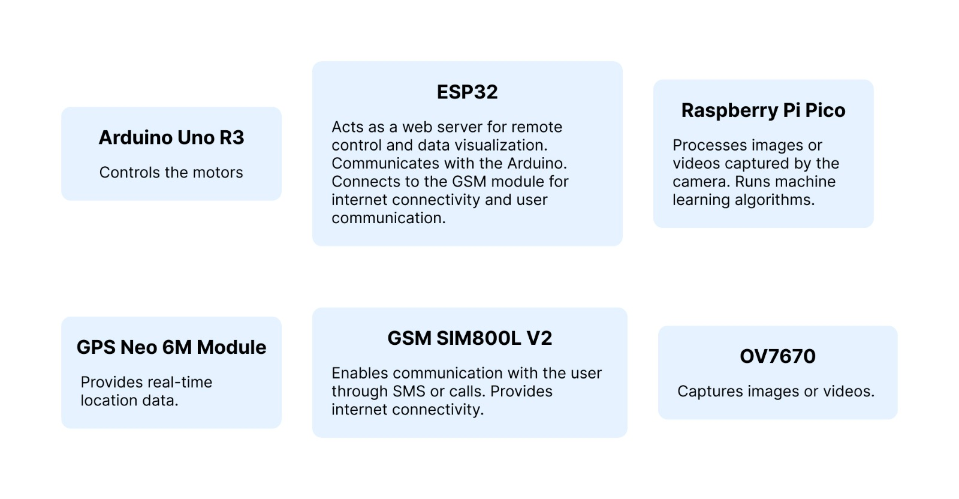
Usage of Hardware Components

Slide 5
Project idea
The main purpose of the project is to provide a reliable anti-theft system aiming to significantly boost vehicles security which in return would deter or mitigate vehicle theft cases.
We plan to achieve this using innovative and cutting-edge technologies.

Slide 6
Our approach
Using Machine learning to perform real-time face recognition of the current driver and notify the owner if the driver is someone that doesn't usually use the vehicle or not from the people allowed to use it.
Provide further warning if the vehicle engine was started.
Give the owner the ability to prevent starting the engine if needed.

Slide 7
Our approach
Keep track of the vehicle location in realtime.
Allowing the owner to record a realtime stream at any given time.
Activate door locks if the vehicle supports this feature.

Slide 8
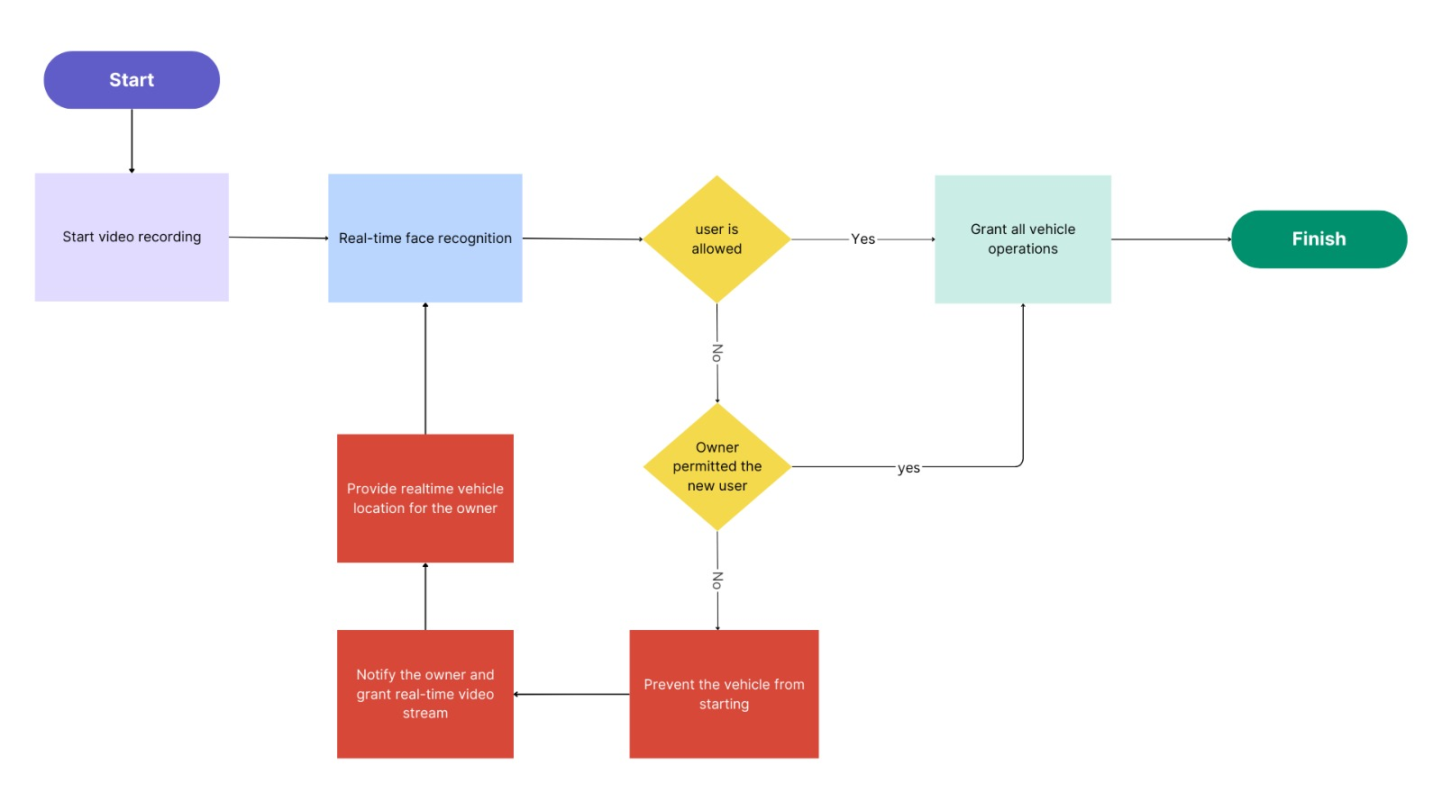
Demo of Project Code Flow-Chart

Slide 9
Thanks For Your Time

